Slide 1
The Sparks Foundation
Task 2
Payment Gateway Integration
Submitted by
ROHIT KUMAR

Slide 2
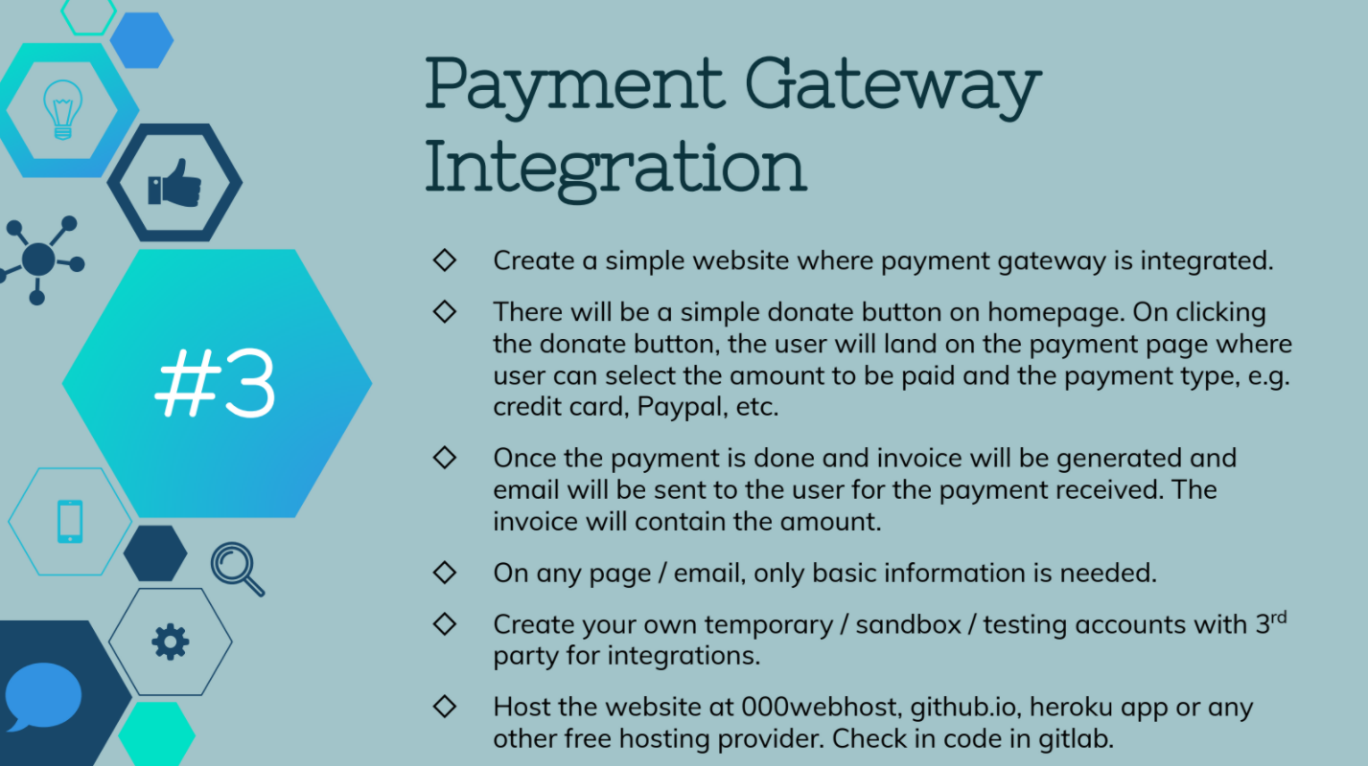

Slide 3


SOURCE CODE

Slide 4

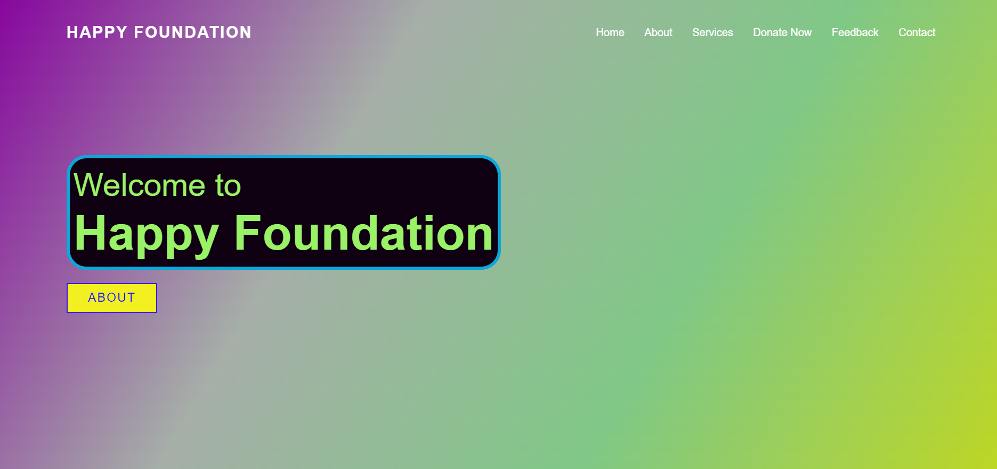
OUTPUT

